Slide 1
Attendment android based mobile attendance system
By Anubhuti gupta
199301171
Under the guidance of
Dr. ankit shrivastava

Slide 2
Problem statement →

Slide 3

Meet nidhi
Nidhi is a Math Teacher.
Nidhi’s daily routine includes→
Teaches Math for 45 minutes.
Reserves 15 minutes for attendance.

Slide 4

Meet vaibhav
He is one of the most popular students of his class.
He always gives attendance on the behalf of his friends.

Slide 5
Problems nidhi face →
Marking proxy attendance
Spending extra time in verifying valid attendance.
Eventually exhausting teaching time.

Slide 6
Defining the problem→

Slide 7

In educational institutions students’ attendance management is an important and tedious task.
Traditional ways→
teacher’s call out names of students, while they attend to their roll call
teachers pass a sheet of paper where students can write their names

Slide 8



Both these methods introduce great wastage of →
Paper
Time
and effort resources
Apart from which there exists chances of proxy attendance being marked

Slide 9
Solution →
Attendment
Your one stop destination to attendance management

Slide 10
What do we do? →

Slide 11


Attendment, is an Android based Mobile Attendance System which caters to the above problem statement by digitising the process and introducing fingerprint verification at the student end.

Slide 12
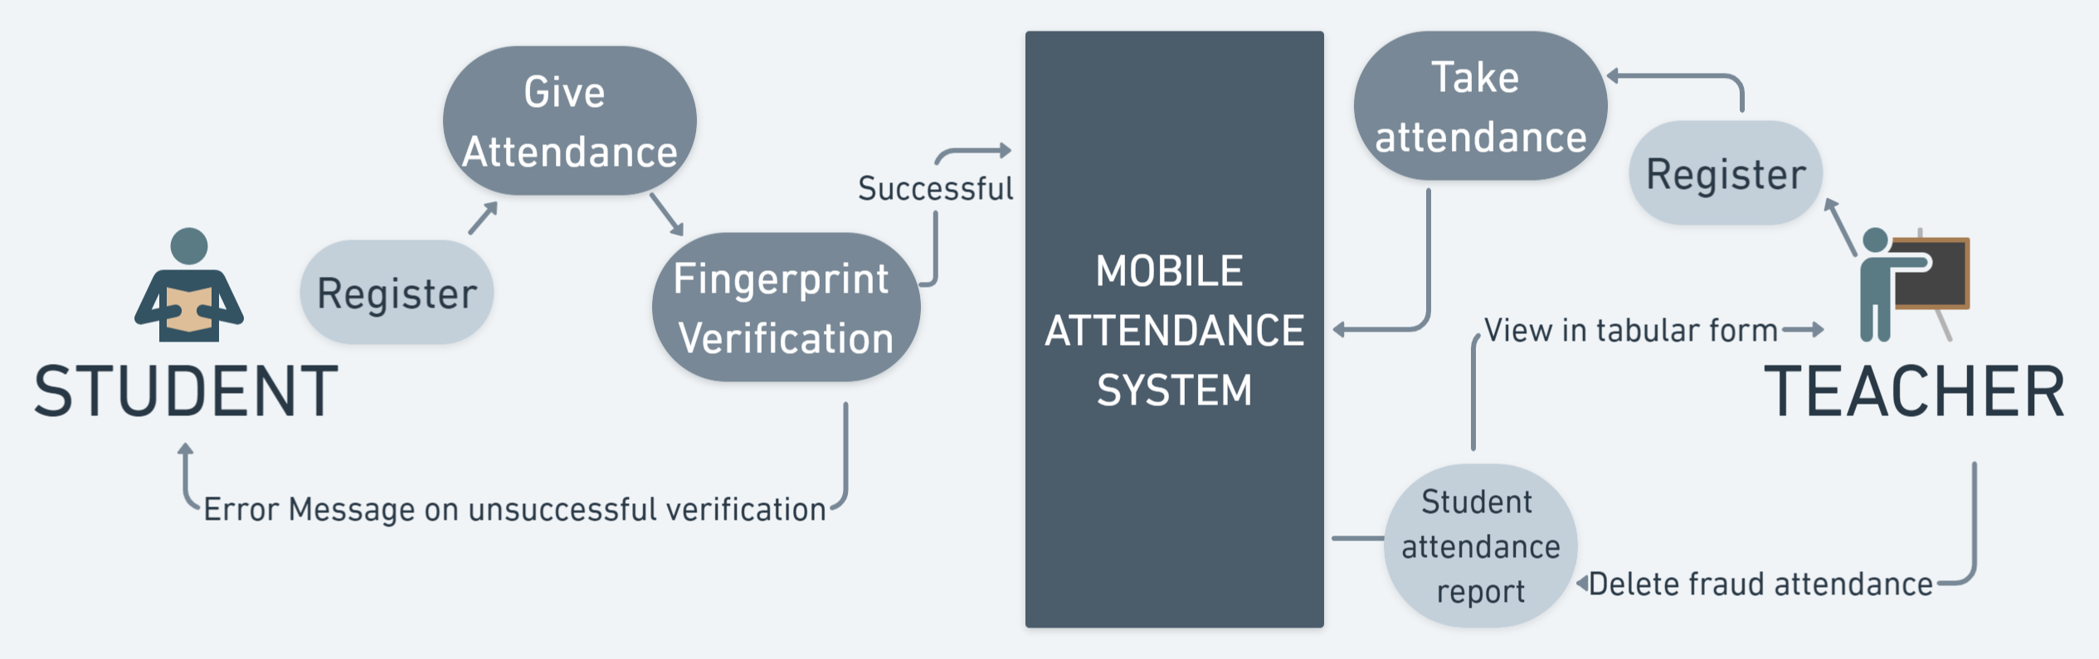

Slide 13
The flow →

Slide 14
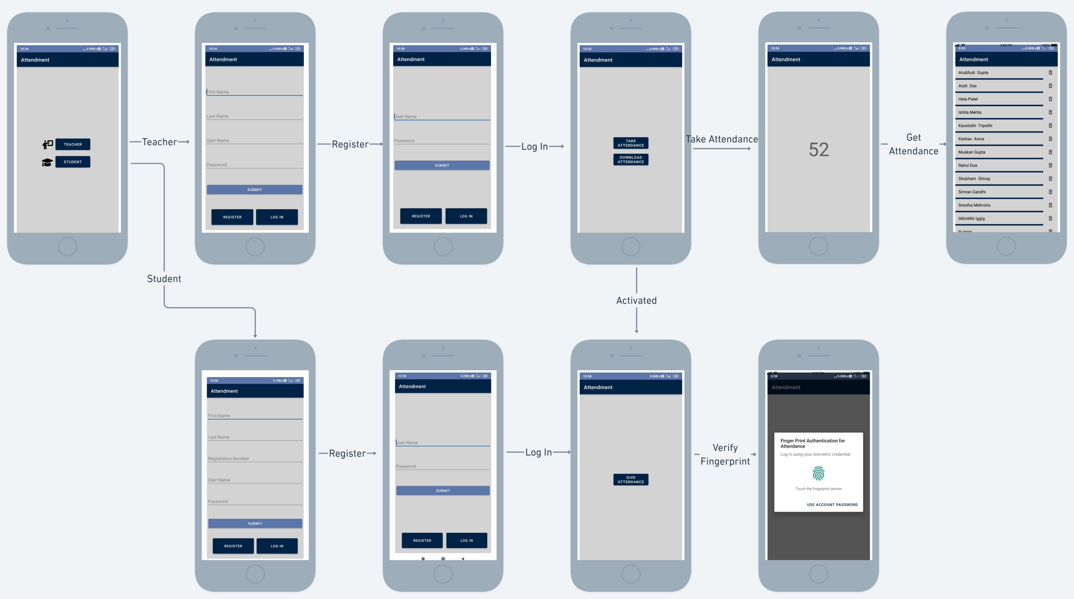
A student enters the platform and registers himself. On his next visit the student can log in to his account with the username and password created at the registration phase. After successful login, the student is directed to Student’s Dashboard. Here he can see a button to “Give Attendance” which is disabled by default.

Slide 15
A teacher enters the platform and registers himself. On successful login, the teacher is directed to Teacher’s dashboard. He clicks the “Take Attendance” button and is directed to a new page. Here they can see a timer of 60 seconds, which is the time limit till which students can give their attendance.

Slide 16
Once allowed, students can click on the “Give Attendance” button. After clicking they are prompted to verify their fingerprint. If not verified they are prompted with an error message. Once successfully verified, their attendance is recorded in the system.

Slide 17
Once the time is over, the Teacher is directed back to the dashboard, where now he can “Get Attendance” in a tabular form.

Slide 18
Demo Time →

Slide 19
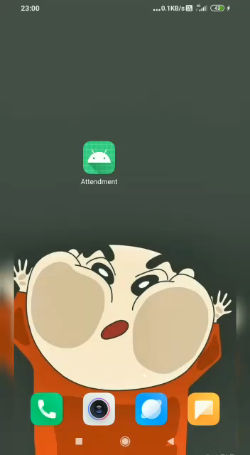
Teacher’s portal

Slide 20
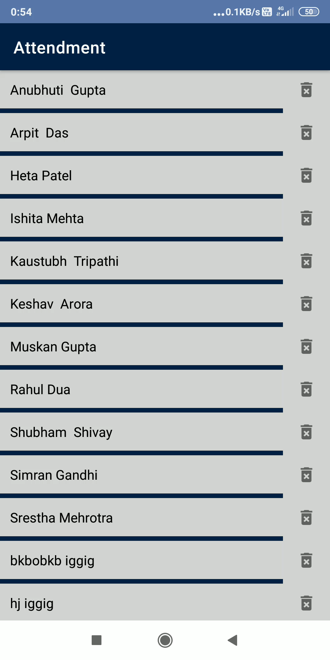
Teacher’s portal
Teacher’s portal

Slide 21
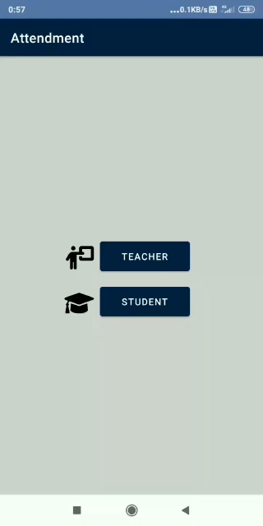
Teacher’s portal
Student’s portal

Slide 22
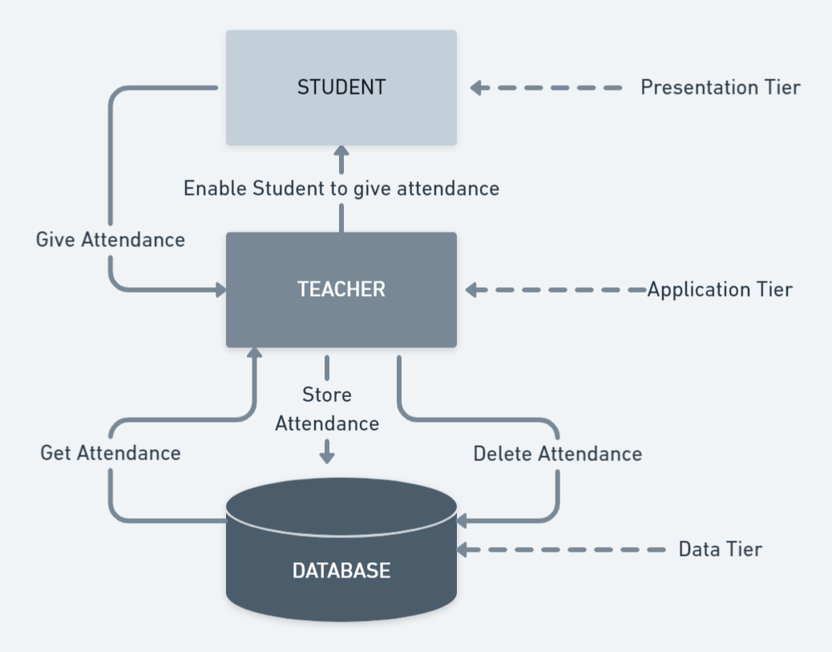
System architecture
We follow a three-level architecture because Teacher as a user has more authority and direct contact with the database of the

Slide 23


Development Environment
Tool → Android Studio
Software → Windows 11, Xiomi Redmi Note 5 (as Android Device Support)
Programming Language → Kotlin

Slide 24
Conclusion
We provide a hassle-free digital solution to otherwise traditional system of attendance management in educational institutions. By proposing this solution, we cut down on unnecessary wastage of paper and time resources at the end of the teacher. Added to that we eradicate the chances of proxy attendance by providing →
Disabled buttons at student portal until the teacher enables them.
Short span of only 60 seconds to give attendance at student portal.
Fingerprint verification of students at time of giving attendance.

Slide 25
Scope / future plans
Bluetooth Integration → Only the students at a close proximity with the teacher’s device are eligible to give attendance.
Network Establishment → Only the students using the same Wi-Fi as the teacher’s device are eligible to give attendance.

Slide 26
Thankyou !

